Slide 1

PVT Manager
Quick Tutorial

Slide 2
Introduction
Contents
Access
Managing Test Cases – Main View
Managing Test Cases – Editing
Managing Test Cases – Change Requests
Managing Test Cases – Translations
Managing Test Cases – Handling Jobs
Managing Test Case Sequences
Managing Truck Functions
Reports
Vehicle Localizer
Vehicle Specifications
Vehicle Planner
Tools
System Demands
Purpose
The PVT Manager provides a set of tools to manage the PVT test cases and to create test case sequences.
Installation
Use installation package provided by eFACTS support when installing for the first time. Version updates of the application will be automatically performed at start up.

Slide 3




Access
User Rights:
The application has 4 different user right levels that give access to different functionalities. Administrator, Editor, Testleader and Guest. In this tutorial the different user right levels are represented by the following icons.
Administrator: Editor: Test Leader: The ”Guest” user level is not considered (view functionality only).
These symbols are used in the presentation to show access to different functionality.
Roles:
A user can also be given different roles that will have impact on the application functionality.
These roles mainly control the functionality regarding test case editing and handling of jobs.
An administrative role for system configuration are also available.
Editor Roles
There are 3 different editor roles.
Master Editor
Site Editor
Test Leader
Administrative Roles
Tools
Test Leaders on site
Site Editor
Test Leaders on site
Master Editor
...
...
Test Leaders on site

Slide 4
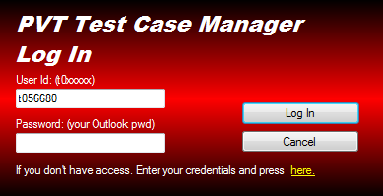
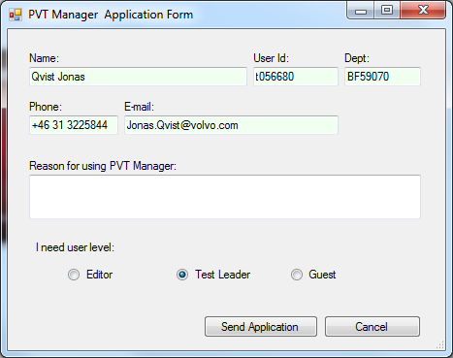
Access
You log on to the application by using your Volvo network credentials. If you don’t have access to the PVT Manager you can apply for it by using the link at the bottom of the Log In form.

Slide 5
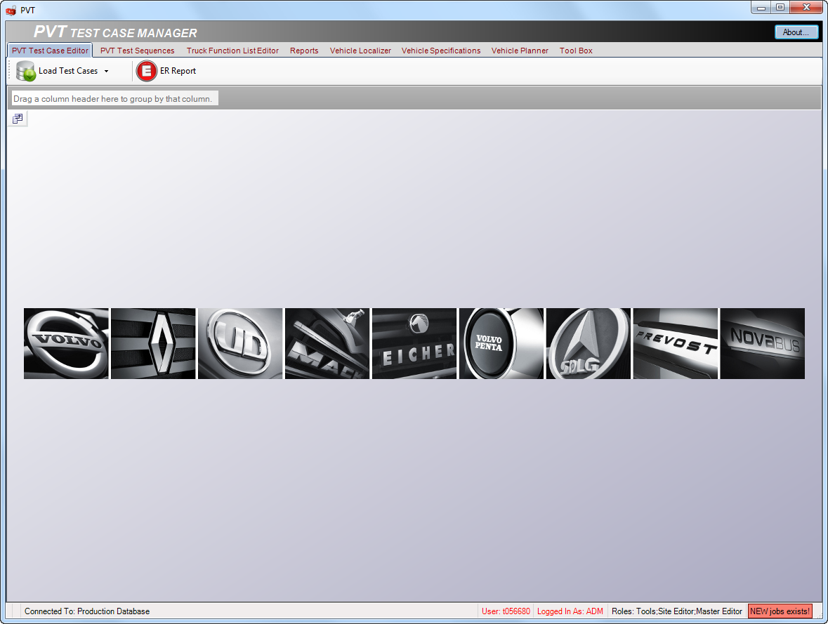
Managing Test Cases – Main View
Start by loading the test cases from the database.

Slide 6
Managing Test Cases – Main View
Statusbar information:
Test Case counter.
A=active, E=edit, P=pedning
Database connection.
Tells which database you are connected to
Log In information
User, User rights and roles
Job indicator
This area indicates if there are any new
jobs to attend to.
(See JobHandler)

Slide 7
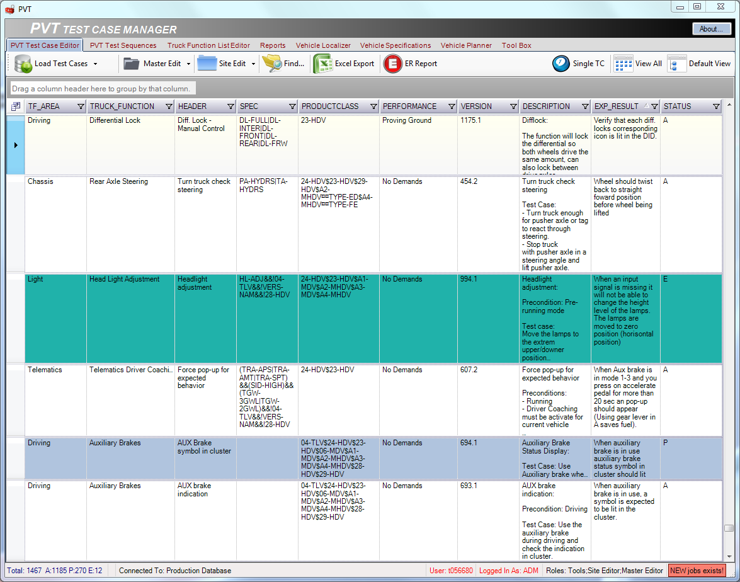
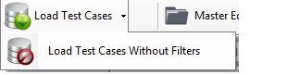
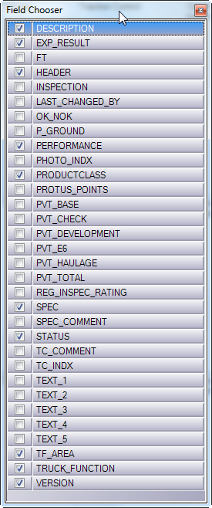
Managing Test Cases – Main View
Column field chooser
Customize your column selections
The filter settings are saved and restored when loading the grid using ”Load Test Cases”. The restore to default settings use ”Load Test Cases Without Filters”.
Select a test case by clicking on the row selector.
Test Case Status
Old: This status is not shown in the main grid. Select a test case and press ”Single TC” to show history.
Edit: This test case is incomplete and
is not available in sequences.
Active: This test case is complete and
can be used in sequences.
Pending: This test case is made inactive
and is not available in sequences.

Slide 8
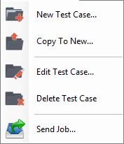
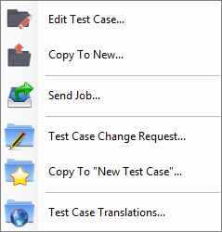
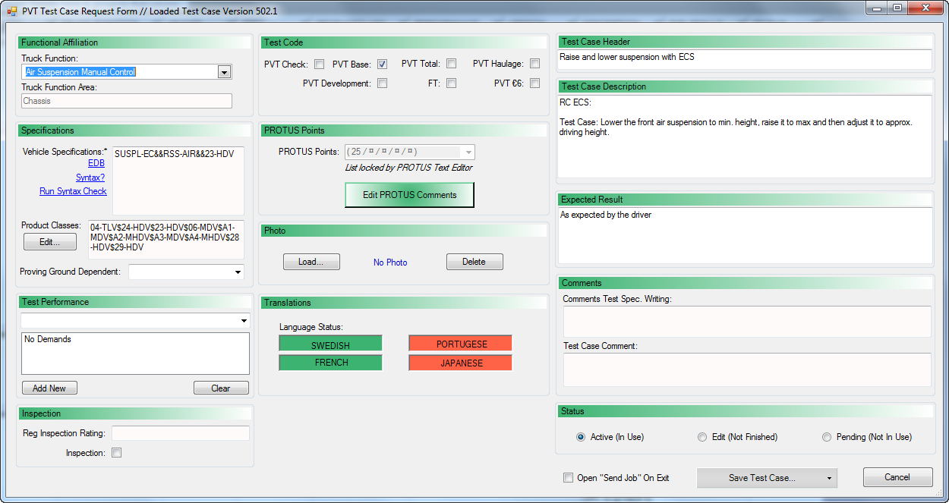
Managing Test Cases – Editing
Editing test cases in database:
The menu items for editing test cases are marked with black folder symbols. You can use the ”Master Edit” menu in the toolbar or the context menu wich will appear if you right click on the grid after selecting a test case.
The form for edting testcases can be opened in 3 different ways.
New Test Case: Opens an empty form.
Copy To New: Copies a selected test case into the form to use as a template.
Edit Test Case: Opens selected test case for editing.
Master Edit
Context menu

Slide 9
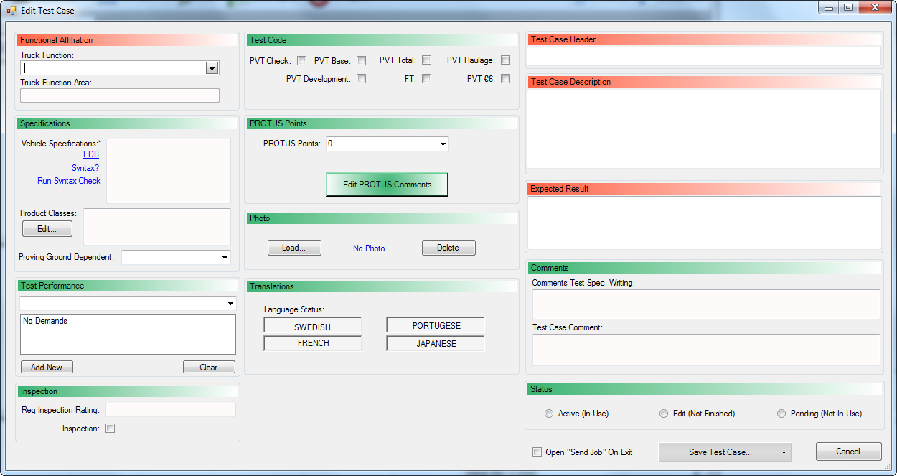
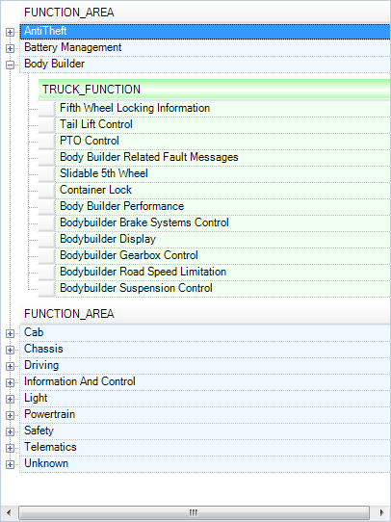
Managing Test Cases – Editing
The groups marked in red are mandatory and has to be filled in to be able to use the test case.
Select a Truck Function from the list by using the row selector.

Slide 10
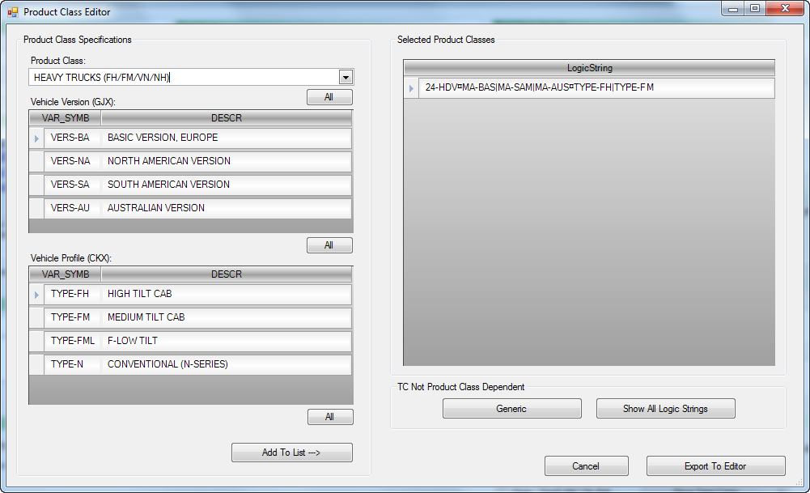
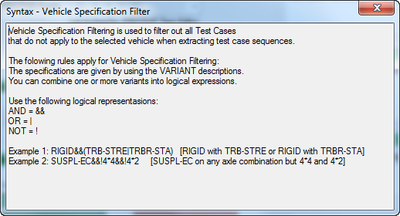
Managing Test Cases – Editing
Select product class, versions and profiles if available.
Create the product class filter string by using the PC filter tool.
If test case is valid for all PC’s use ”Generic”
If you shall add many PC’s use ”Show All Logic String” to display all PC’s. You can then delete from the list by using the row selector and press delete.
When ready, ”Export To Editor”
Add to the selected list

Slide 11
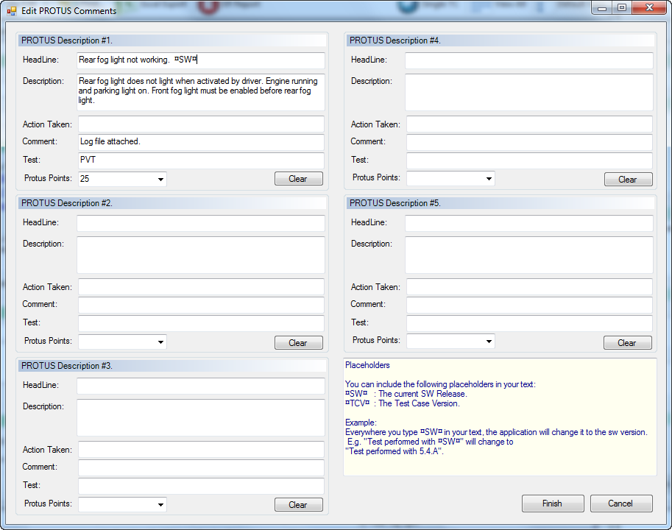
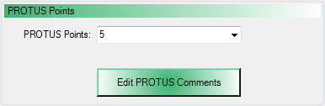
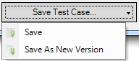
Managing Test Cases – Editing
The PROTUS points can be set in two ways.
Select from the list
Open the PROTUS Text Editor
Saving a new test case will generate a new main version number. (Ex. 650.1)
An altered existing test case can either be saved as ”New Version” wich will generate a new sub-version number (Ex. 512.2) or just updated with ”Save”.
If ”Open ’Send Job’ On Exit” is checked when saving, the Send Job form will be shown.
5 possible errors can be predefined. (See description for placeholders.)
These texts can be used as default descriptions in eFACTS Data Refiner and in PROTUS.

Slide 12
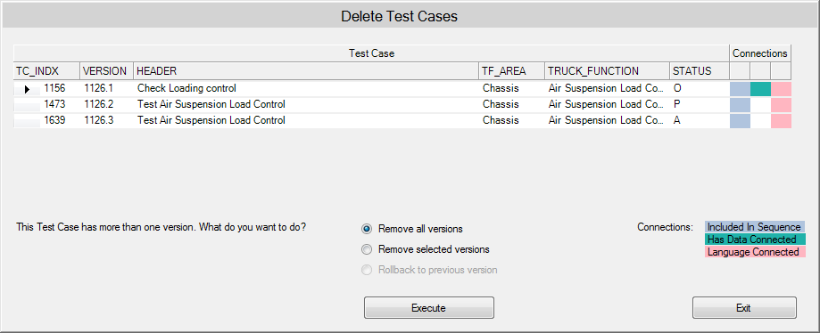
Managing Test Cases – Editing
Deleting test cases in database:
The menu items for editing test cases are marked with black folder symbols. You can use the ”Master Edit” menu in the toolbar or the context menu wich will appear if you right click on the grid after selecting a test case.
Master Edit
Be careful if data is connected to a test case!

Slide 13
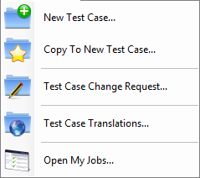
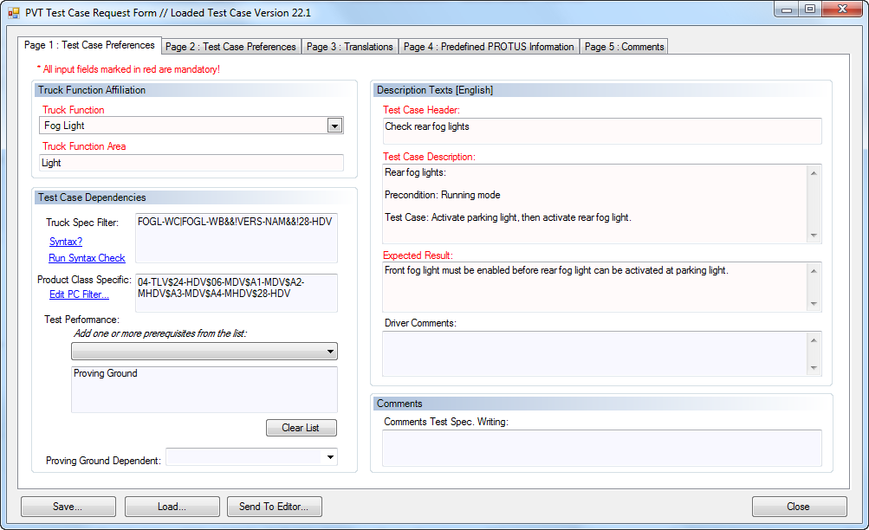
Managing Test Cases – Change Requests
Requesting for new test cases or changes in existing test cases:
As a user with test leader user rights you can only request for new test cases or changes. You cannot edit the database content. The menu items for change requests are marked with blue folder symbols. You can use the ”Site Edit” menu in the toolbar or the context menu which will appear if you right click on the grid after selecting a test case.
The form for requesting changes can be opened in 3 different ways.
New Test Case: Opens an empty form.
Copy To New: Copies a selected test case into the formto use as a template.
Edit Test Case: Opens selected test case for editing.
Site Edit
Context menu

Slide 14
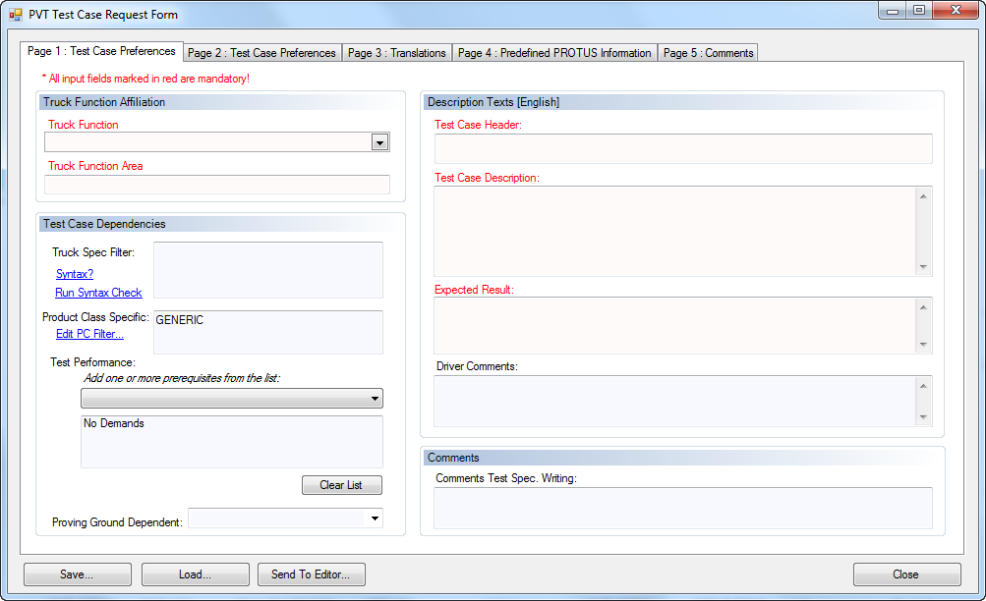
Managing Test Cases – Change Requests
All fileds marked in red on page 1 and page 2 are mandatory to be able to send a request.
Select a Truck Function from the list by using the row selector.

Slide 15
Managing Test Cases – Change Requests
Select product class, versions and profiles if available.
You can add one or more prerequisutes to the test case that can be used later on for sorting and filtering.
Create the product class filter string by using the PC filter tool.
If test case is valid for all PC’s use ”Generic”
If you shall add many PC’s use ”Show All Logic String” to display all PC’s. You can then delete from the list by using the row selector and press delete.
When ready, ”Export To Editor”
Add to the selected list

Slide 16
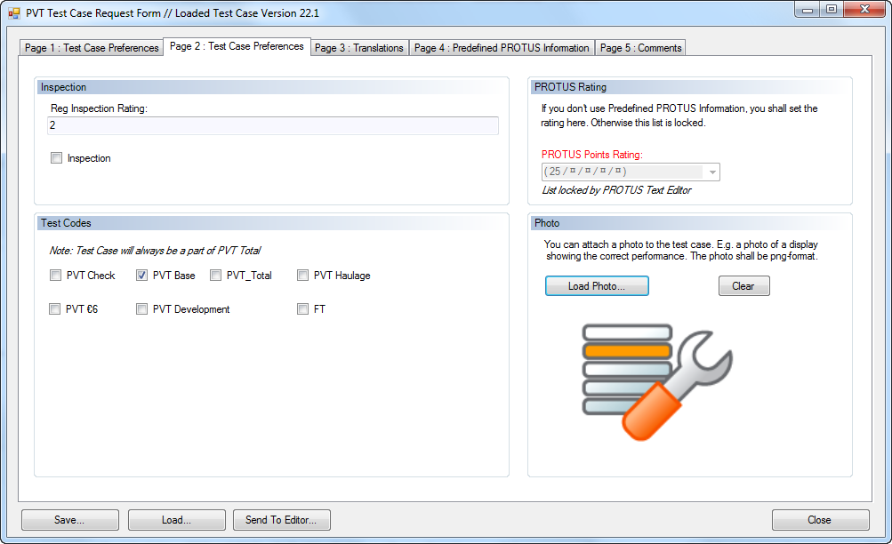
Managing Test Cases – Change Requests
PROTUS points are either set by selecting from the list or by using the predefined texts on page 4.
If you have set predefined PROTUS information, the selection list is locked.

Slide 17
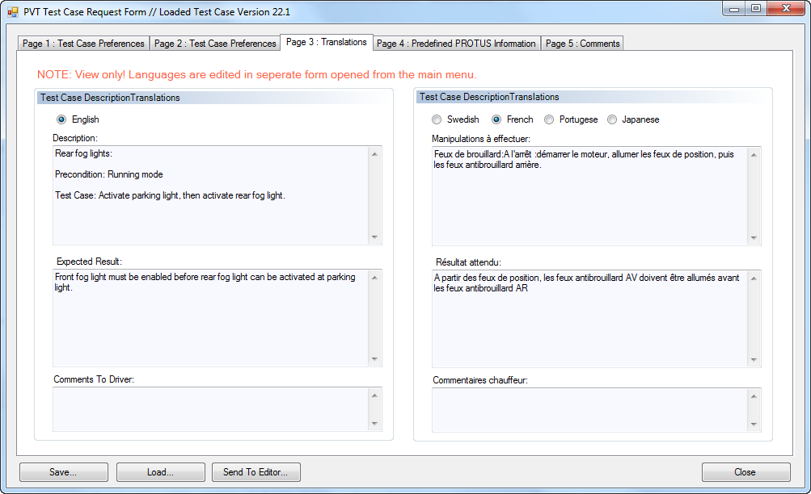
Managing Test Cases – Change Requests
This page is for viewing only. Language translations are performed in a separate form.
Switch between languages.

Slide 18
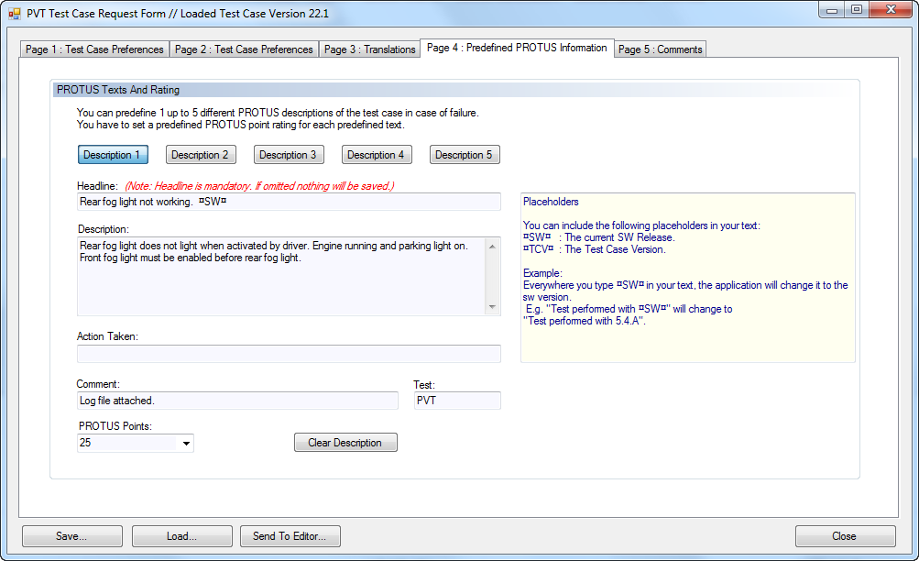
Managing Test Cases – Change Requests
On this page you can edit predefined texts for 1 up to 5 errors that might occur.
Note the use of placeholders.

Slide 19
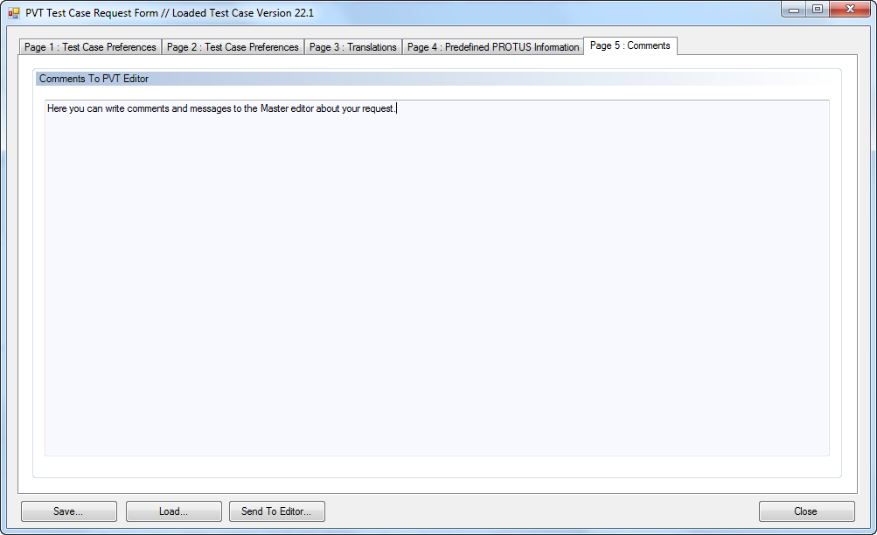
Managing Test Cases – Change Requests
You can save and load testcases locally on your computer.
When you are ready, send the request to the master editor.

Slide 20

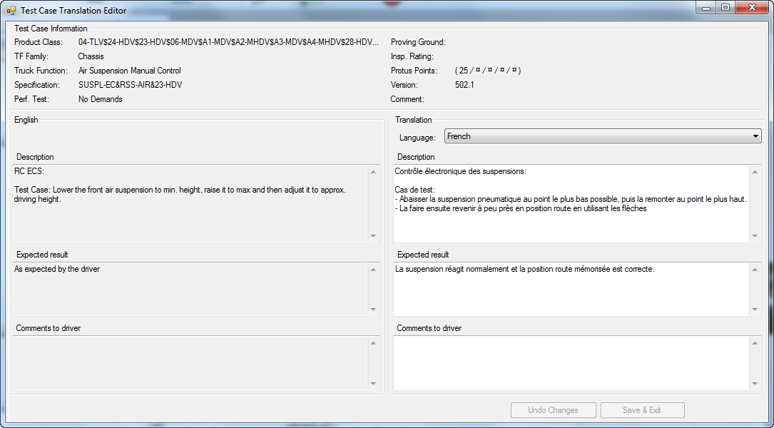
Managing Test Cases – Translations
Translating test case information into different languages:
+
Translations of test case information is the responsability of the site editor. It is only possible to translate the following fields:
Description
Expected Results
Driver Comments
This is the basic information used when exporting test case sequences for the drivers.
Note: Changing the translations in this form will perform changes directly in the database.
Context Menu (Right Click)
Site Edit Menu
Reference language is always in english.
Select language to edit.

Slide 21
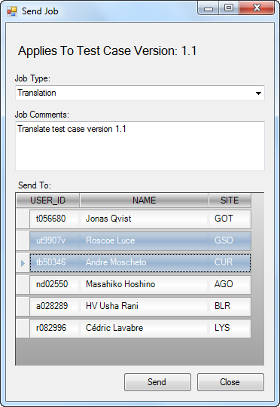
Managing Test Cases – Handling Jobs
Creating and handle jobs:
To be able to manage different tasks like reviewing test cases, translations of new test cases, handle change request etc., a function to handle ”jobs” are available. All jobs are located in the form ”JobHandler” and are available for Master and Site editors.
There are four different types of jobs:
New Test Case New test case created . Can be created by testleader or site editor.
TC Change Request Existing test case that needs to be modified or corrected. Can be created by testleader or site editor.
Review Job that needs to be reviewed by the site editors. Can be created by master editor.
Translation Job needs to be translated into site local language. Can be created by master editor.
Creating jobs:
Jobs can be created from two different locations.
By sending a request from the Test Request Form. LINK
By initiating jobs from the ”Send Job” form. (Only available for Master Editor and Administrator).
Select Job Type
Master Edit Menu
Use comment field for additional information to the recievers
Select the receiving site editors.
Send jobs.

Slide 22
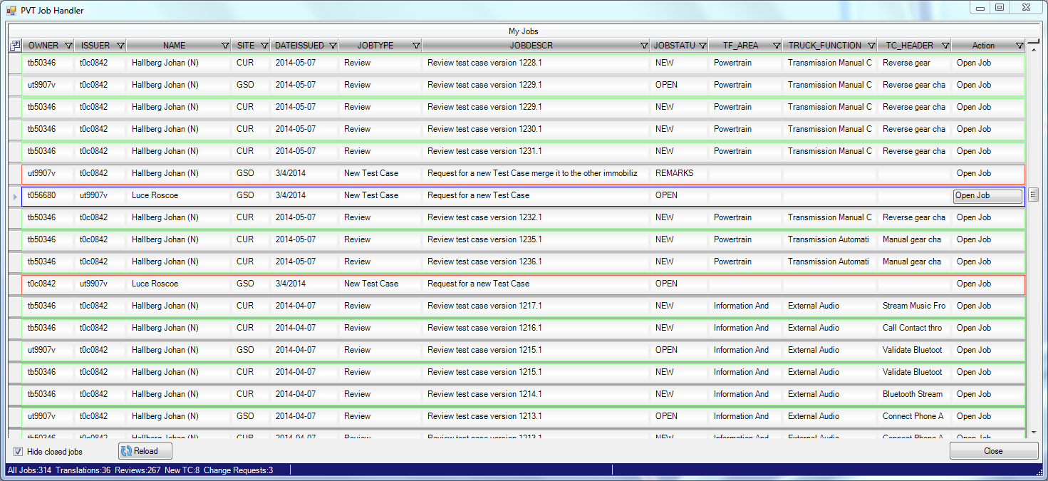
Managing Test Cases – Handling Jobs
In the JobHandler all active jobs are listed.
NOTE:
The jobhandler is not intended to be a channel for communication
between editors. It is just a tool for keeping track of your tasks.
If you need to straighten out issues, use mail, phone etc!!
Status:
NEW – New job of any kind.
OPEN – The job has been opened by the reciever.
REMARKS – A ”Review job” has been sent back with comments
READY – The job is ready
REJECTED – A request for changes or a new test case has been rejected.
CLOSED – Job is closed.
Colors: [Only apply for master editor]
Green: Jobs initiated by Master Editor
Red: Incoming jobs. New or replies.
Blue: Jobs sent to Master Editing Tool.
Open Job by pressing button in the Action column.
You can only open jobs for which you are the owner

Slide 23
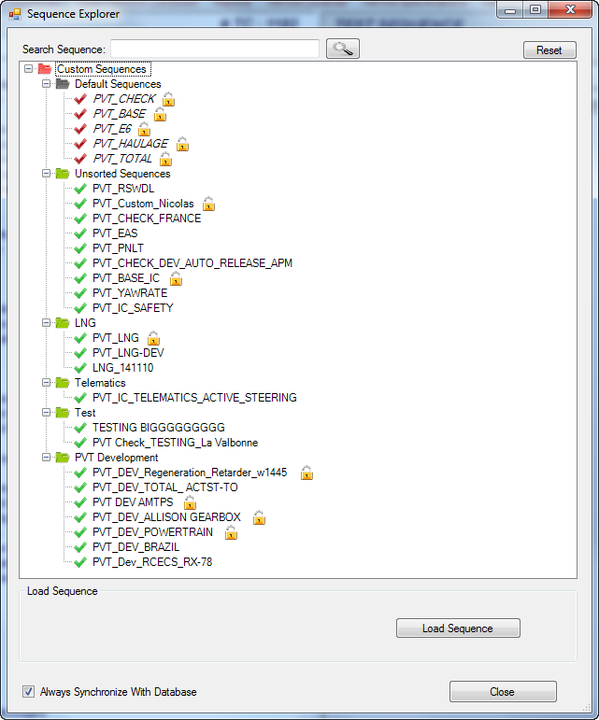

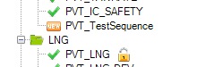
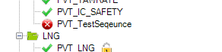
Managing Test Case Sequences
Sequence Explorer
The sequence explorer gives you the opportunity to organize custom sequences in your own way.
The folders ”Default Sequences” and ”Unsorted Sequences” are mandatory and cannot be changed in any way.
The sequence explorer is used when opening, saving and exporting sequences.
Functionality:
New folder: Right click on a valid folder and select ”New Folder”. You cannot create a new folder in ”Default Sequences” and ”Unsorted Sequences”.
Rename folder: Right click on a valid folder and select ”Rename Folder”.
Remove folder: Right click on a valid folder and select ”Remove Folder”. You cannot remove forlders that are not empty.
To move a test sequence between folders or to move a folder, use drag ’n drop. Default sequences cannot be moved.
You can search for a sequence by using free text in the text box at the top.
RESET: Resetting the explorer will reload the treeview and remove all customized folders.
Shows that the sequence is locked. Pointing at the sequence will show who has locked the sequence
Shows that a new sequence is available. This symbol is only shown the first time you open the explorer with a new sequence present.
Shows that a sequence is no longer available. You can right click on the sequence and select ”Remove Sequence” to delete it from your list.
By checking this box the sequence explorer will synchronize against the database each time it loads. Otherwise it will not check for changes but on the other hand load faster.

Slide 24
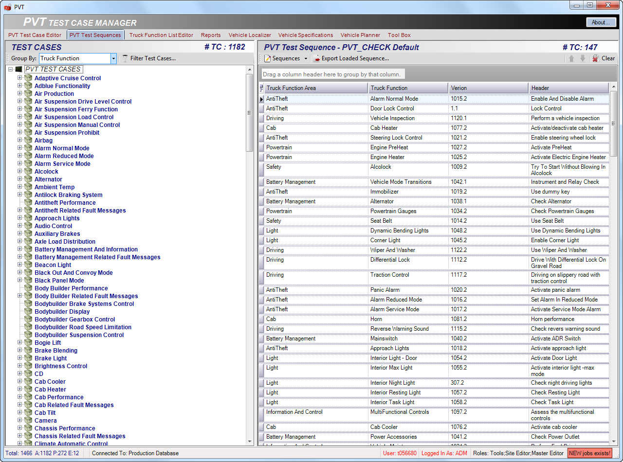
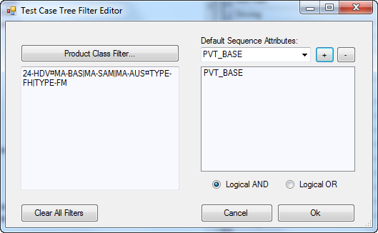
Managing Test Case Sequences
The test case sequence editor is used to create, manage and export sequences.
Some sequences are predefined and are called Default Sequences. All other are Custom Sequences.
Creating Custom Sequences
You can create your own sequences (custom sequences) by selecting test cases from the tree view to the left and move them to the sequence list to the right. Use the ”Group By” and ”Filter Test Cases” function to change the contents of the tree view.
Open filter for test case selection

Slide 25
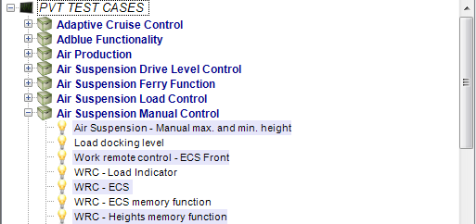
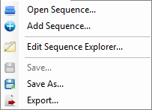
Managing Test Case Sequences
Creating Custom Sequences
Actions:
- Dubbel Click → Open information view [Link to form]
- Right click on selected and hold → Drag ’n Drop to sequence grid
You can also create a custom sequence by opening an existing sequence and change it or by combining existing sequences using ”Add Sequence”.

Slide 26
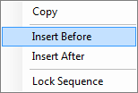
Managing Test Case Sequences
There are two ways to change the order of the selected test cases in a custom sequence.
Select a test case and then use the up/down arrows.
Select one or more test cases and the right click to open the context menu. Select ”Copy” from the menu. Now select the testcase at the position that you want to move the test cases to. Right click and select ”Insert Before” or ”Insert After”.
Context Menu
You can lock a sequence by opening the context menu and select ”Lock Sequence”.
If you lock a sequence nobody else than you can make changes to it or unlock the sequence.

Slide 27
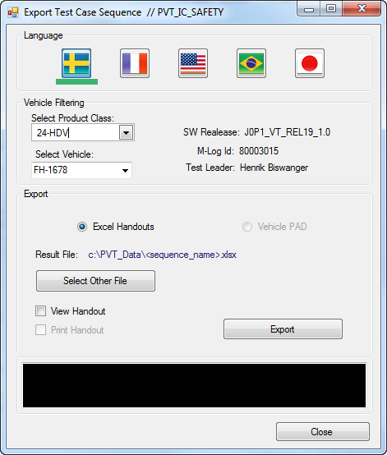
Managing Test Case Sequences
Exporting Sequences
Exporting sequences will generate an excel file to be used by the driver when performing the test.
Export loaded sequence
Select sequence to export
Select the language used for the sequence export.
Select product class and vehicle for wich the export is valid. This will filter out all test cases in the sequence that are not valid for the selected vehicle. If you only select a product class or if both selections are omitted, the sequence will be filtered only by PC or not filtered at all.
The applications suggests a default file name and location. You can change this if you whant.
If you whant to view the excel file at once, tick this checkbox.

Slide 28
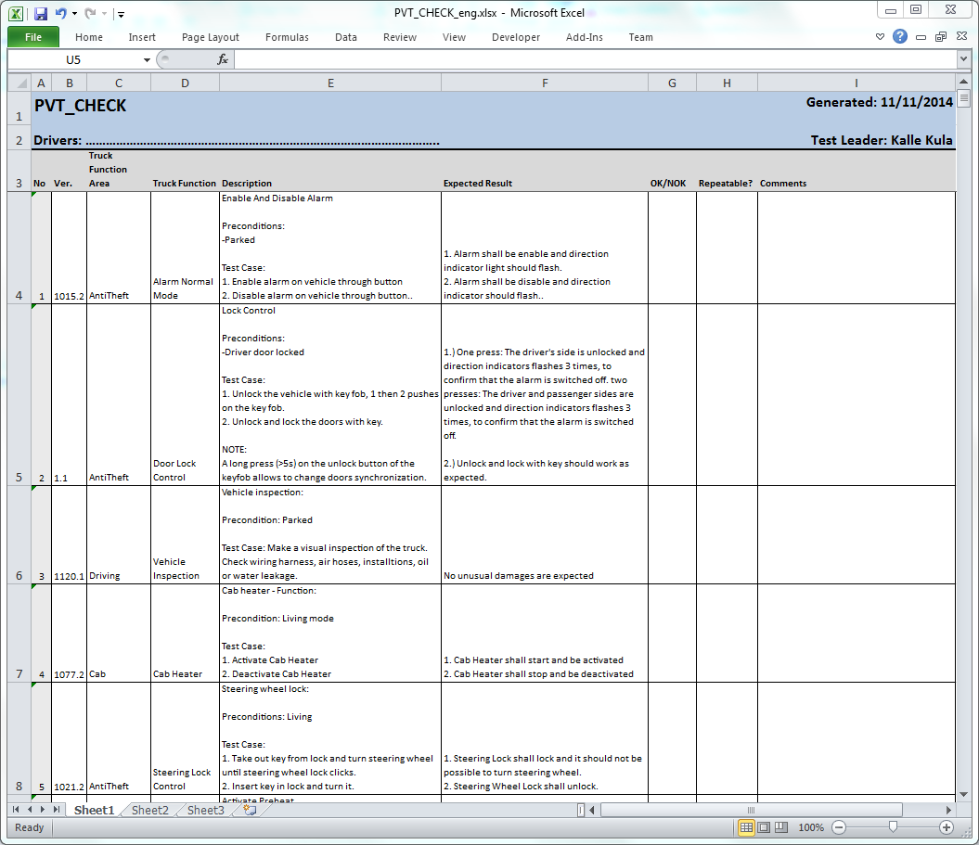
Managing Test Case Sequences

Slide 29
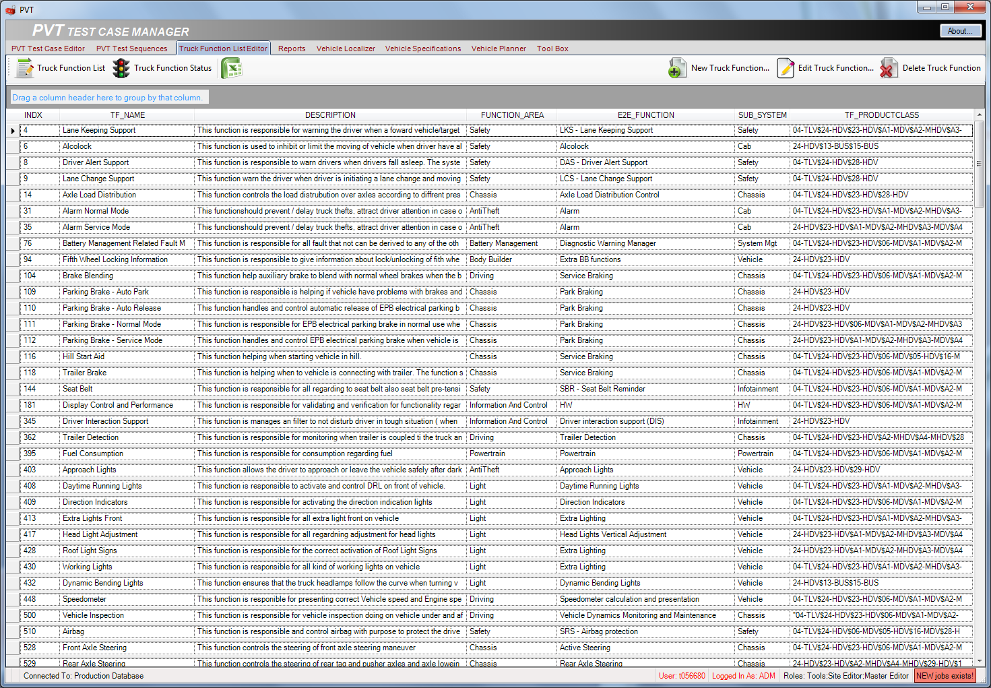
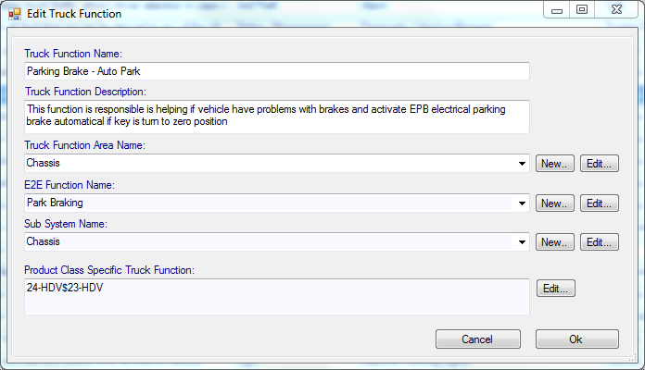
Managing Truck Functions
In the form used for editing and creating new truck functions it is also possible to create/edit the other related classifications such as ”Truck Function Area”, ”End to End Function” and ”Sub System”.
Go here for product class editing.

Slide 30
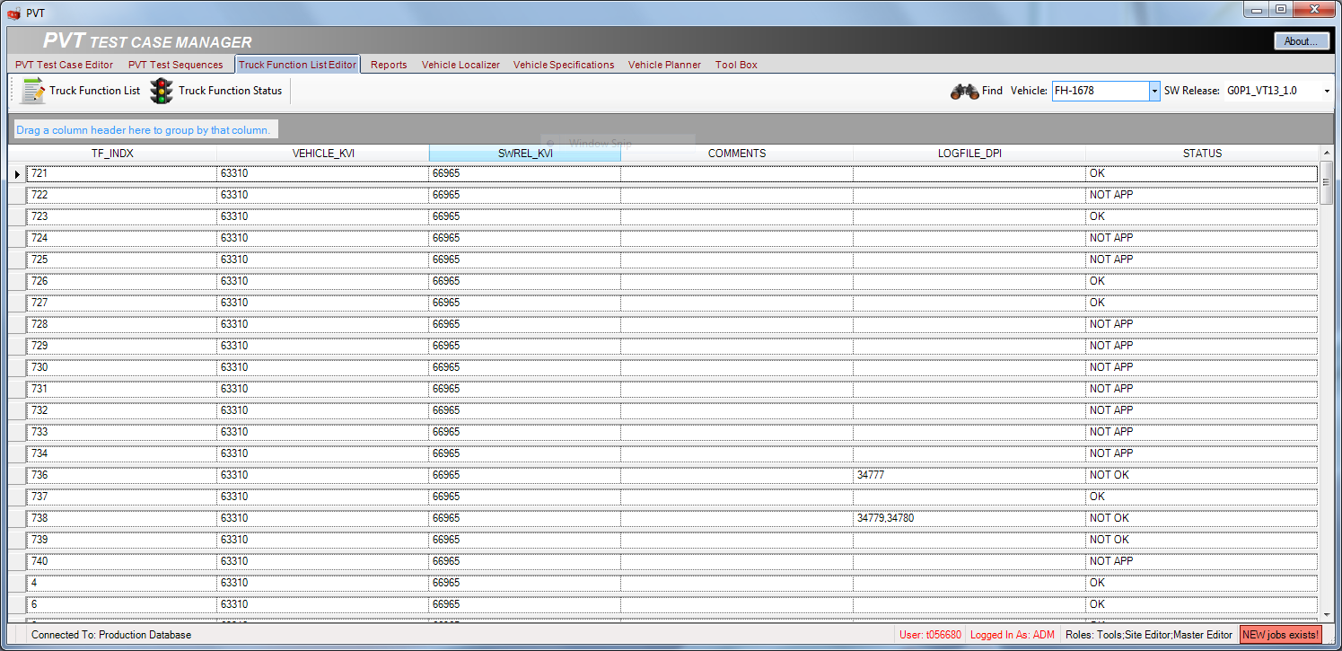
Managing Truck Functions
On this page it is also possible to get an overview of the Truck function status for a selected vehicle with a certain software package.

Slide 31
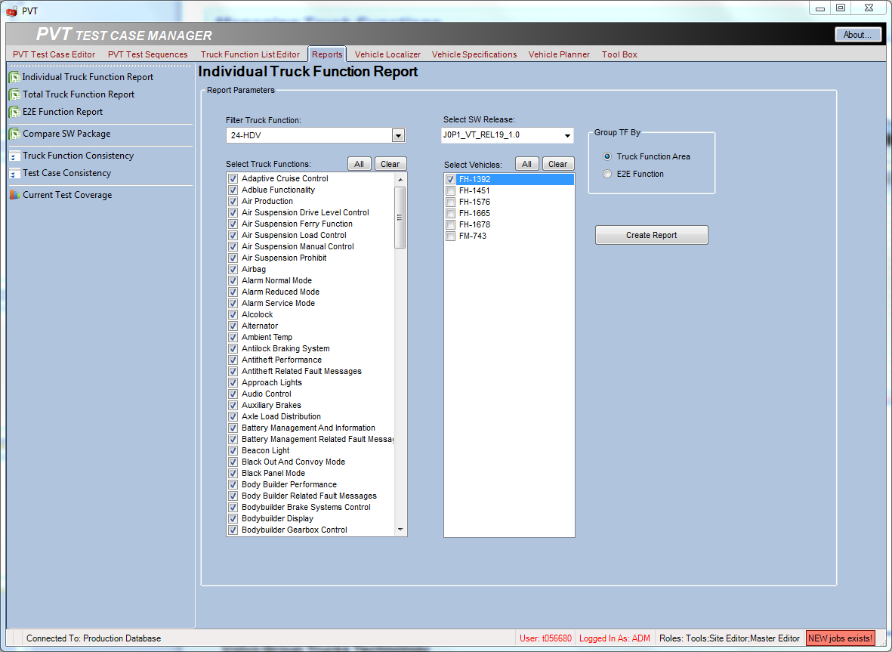
Reports
Individual Truck Function Report
Select the report you want to generate from the report menu.
Select product class to load the truck function list.
Select the truck functions to be present in your report.
Select the software package.
Select the vehicle.
Select how to group the TF’s.
Press ”Create Report” to start generating the xl-report.

Slide 32
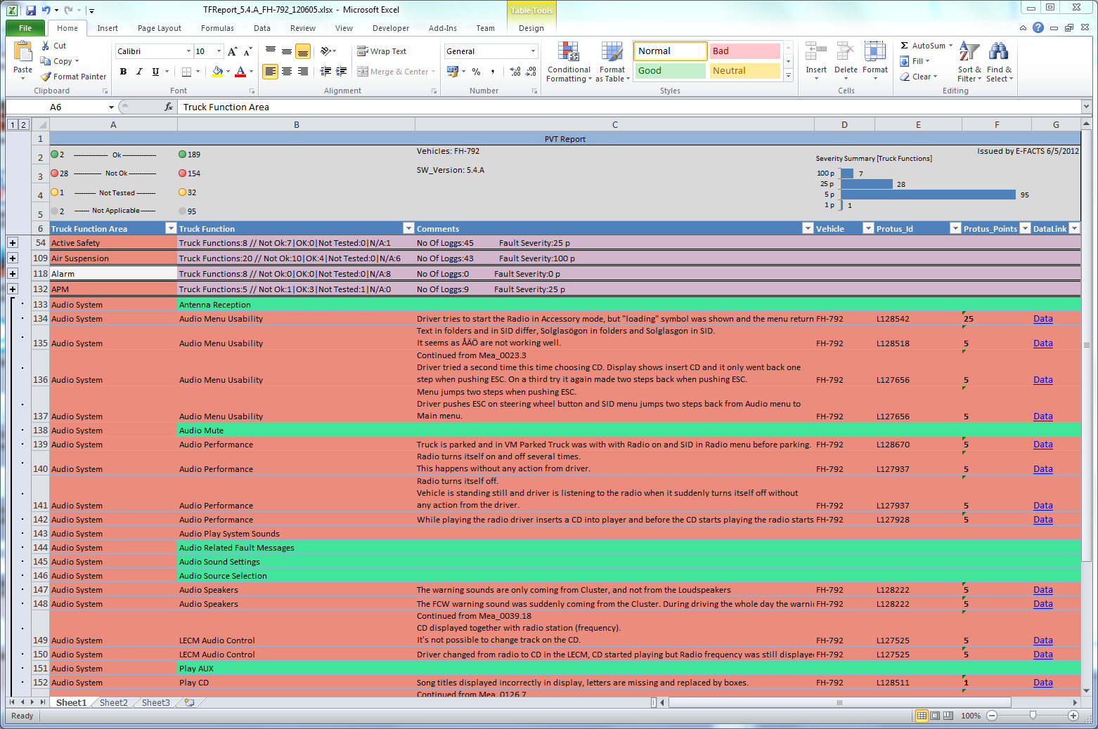
Reports
Individual Truck Function Report

Slide 33
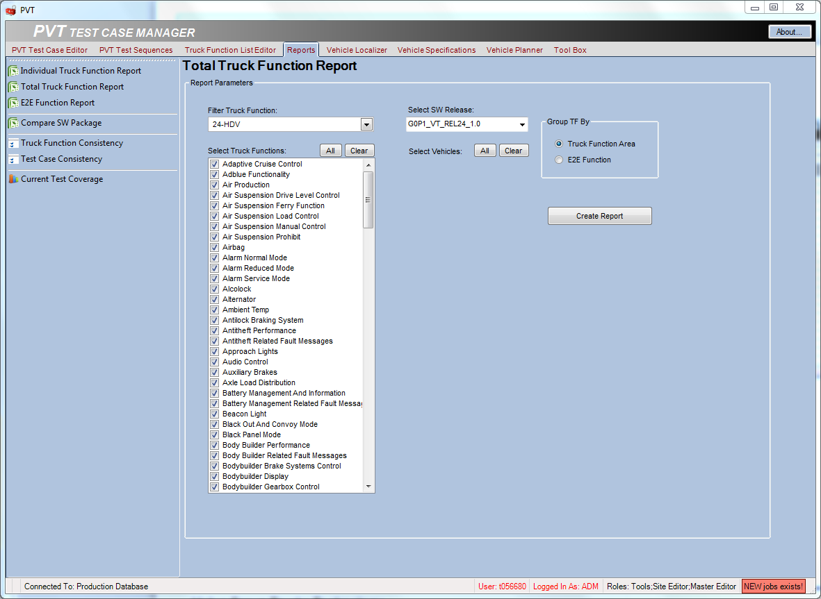
Reports
Total Truck Function Report
Select product class to load the truck function list.
Select the truck functions to be present in your report.
Select the software package.
Select how to group the TF’s.
Press ”Create Report” to start generating the xl-report.

Slide 34
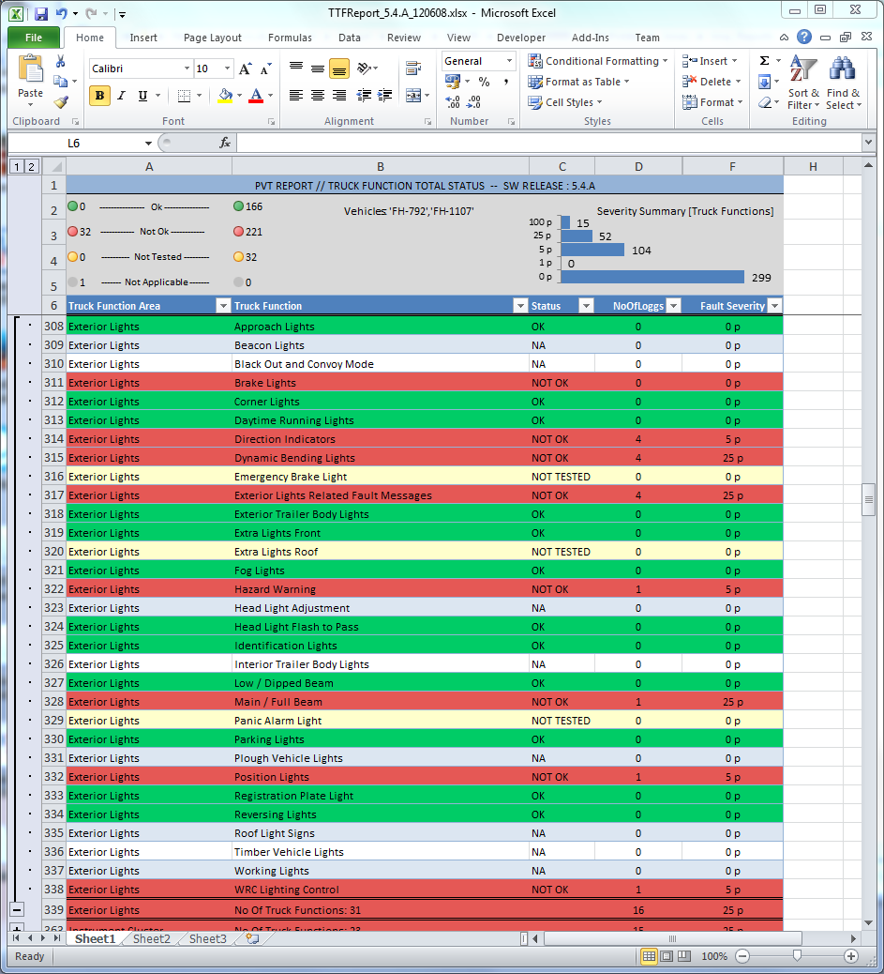
Reports
Individual Truck Function Report

Slide 35
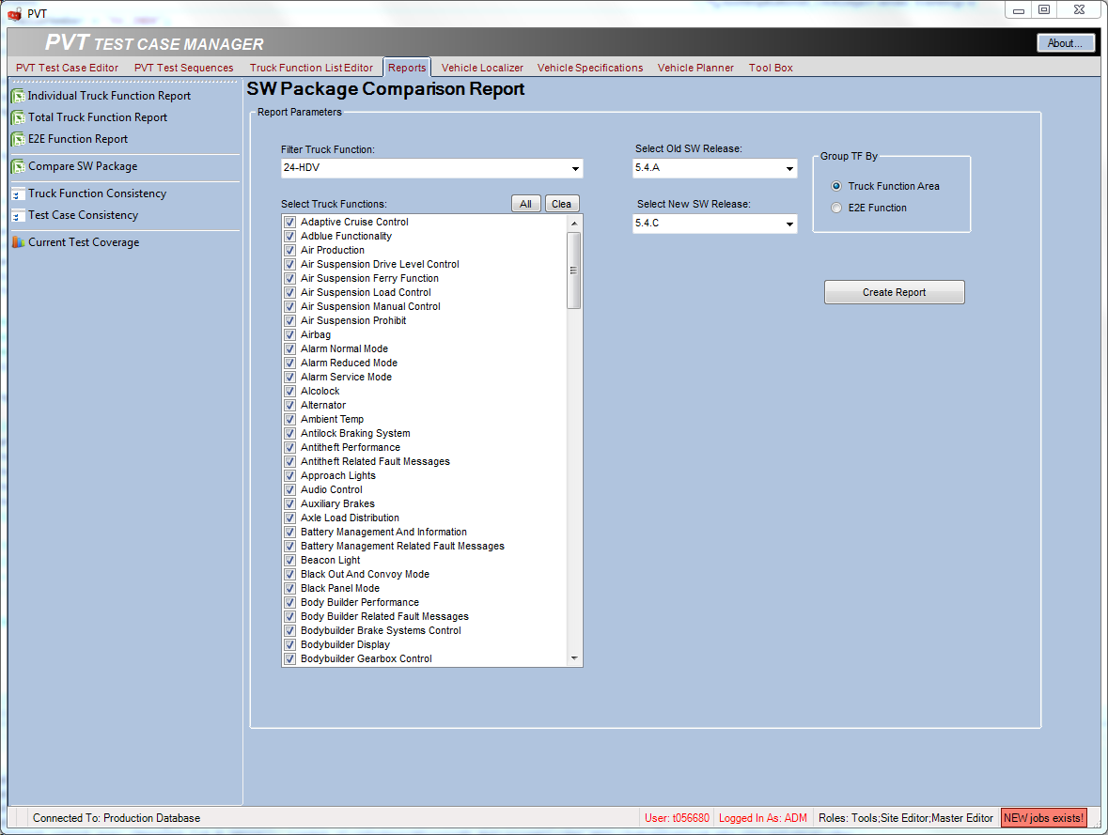
Reports
Individual Truck Function Report
Select product class to load the truck function list.
Select the truck functions to be present in your report.
Select the old software package.
Select the new software package.
Select how to group the TF’s.
Press ”Create Report” to start generating the xl-report.

Slide 36
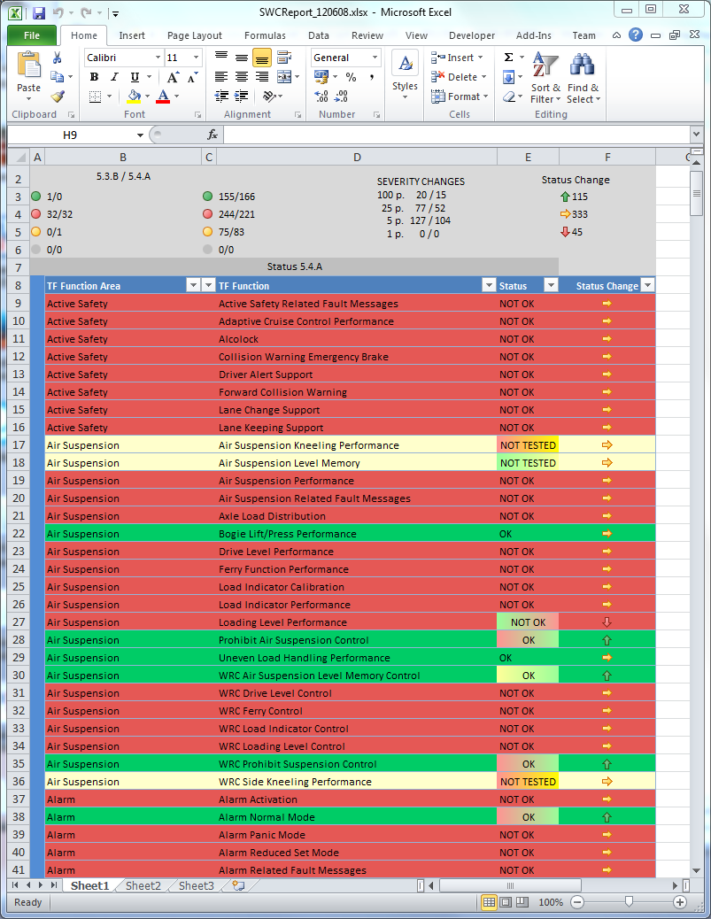
Reports
Individual Truck Function Report

Slide 37
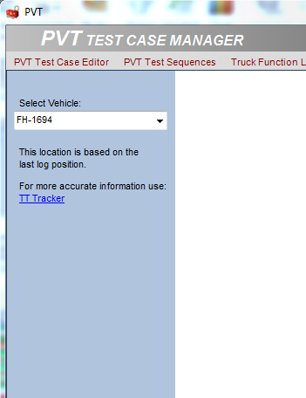
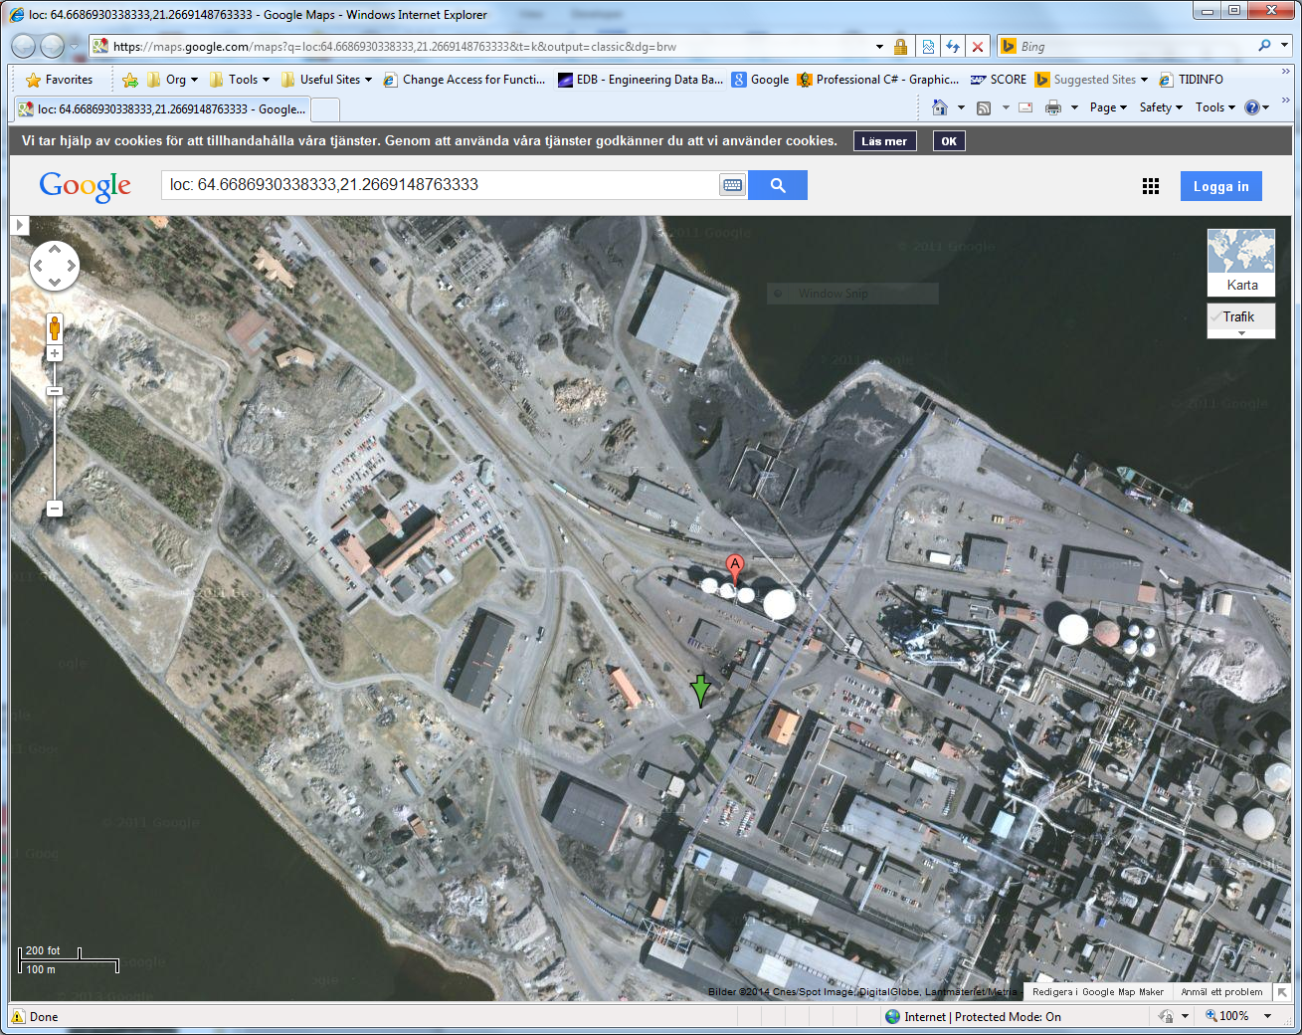
Vehicle Localizer

Slide 38
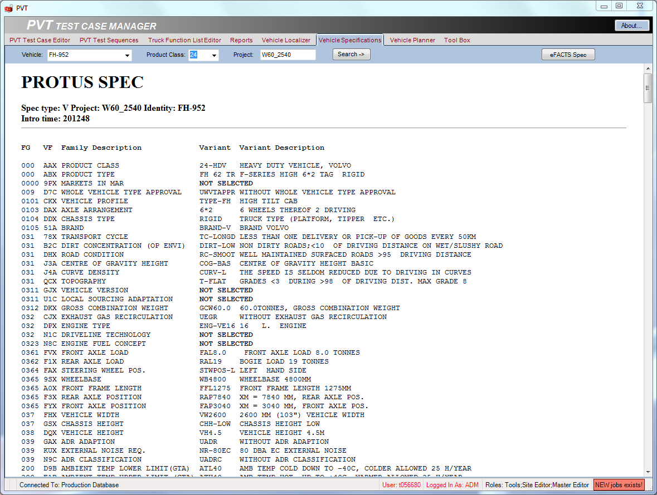
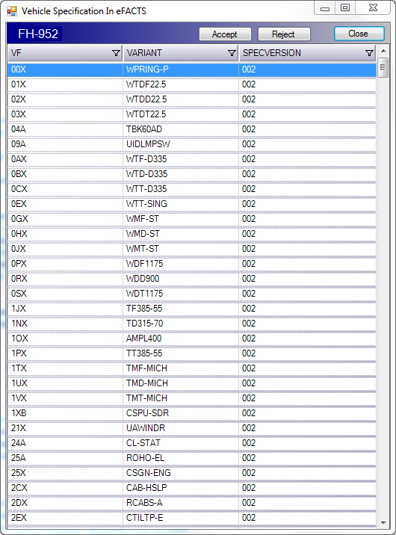
Vehicle Specifications
Vehicle specifications are used to filter out test cases that are not valid for a selected vehicle. Therefore it is important that the vehicle specifications are up to date. To add specifications for a new vehicle, use functions in the ”Tool Box”. Once added to eFACTS, updates is performed automatically
To compare the PROTUS specification with the one imported to eFACTS, you can this function to edit the database directly.

Slide 39


Vehicle Planner
The vehicle planner is used to get an overview of the test case coverage for different vehicles or a combination of vehicles whithin the same product class.
It uses the vehicle specification to filter out test cases not valid for the selected vehicles.
The bars shows the percentage of the total amount of available truck functions covered by the selected vehicles. At least one test case shall be available for the truck function to be considered as covered.
The number in parentesis represents all truck functions (not filtered by product class).
The list shows the amount of covered test cases for each truck function. If not covered at all, it will be marked red. You can select to view only unhandled truck functions or comlete list.
The bars shows the percentage of the total amount of available test cases covered by the selected vehicles.
The bars shows the percentage of the total amount of available test cases covered by the selected vehicles.
Use filter to show coverage for the different tests.
List of the test cases not covered by the selected vehicles.
Drag n’ Drop to select vehicles.
Confidence bar shows how many test cases are redundant for each vehicle. Press button to view details.

Slide 40


Vehicle Planner

Slide 41

Tools

